Slide 1
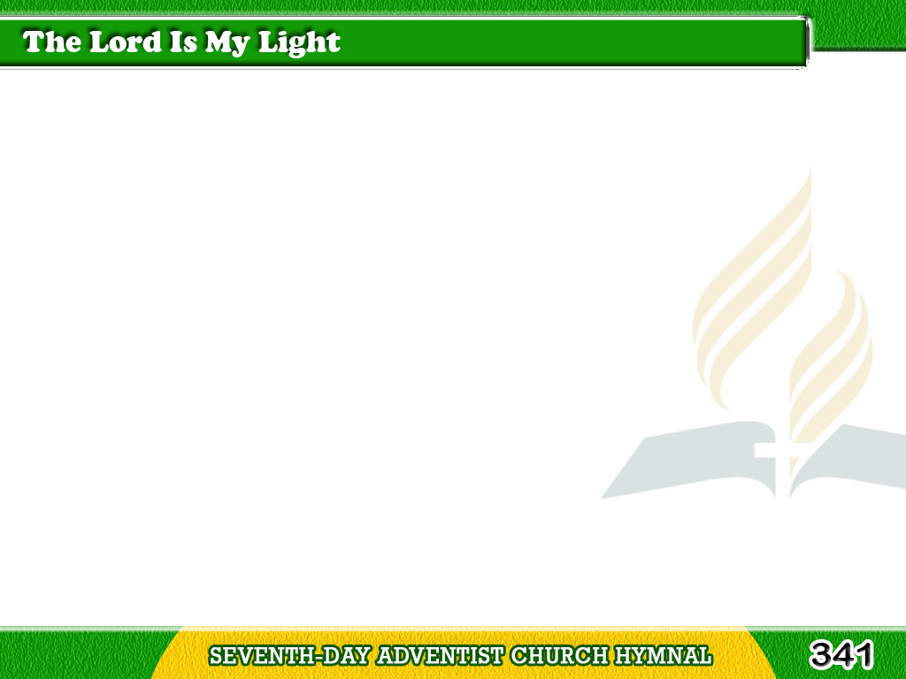
1/4
The Lord is my light;
then why should I fear?
By day and by night
His presence is near;
Tagalog
Version

Slide 2
1/4
He is my salvation
from sorrow and sin;
This blessed persuasion
the Spirit brings in.
Tagalog
Version

Slide 3
1/4
Chorus
The Lord is my light,
my joy, and my song;
By day and by night
He leads me along;
Tagalog
Version

Slide 4
1/4
Chorus
The Lord is my light,
my joy, and my song;
By day and by night
He leads me along.
Tagalog
Version

Slide 5
2/4
The Lord is my light;
though clouds may arise,
Faith, stronger than sight,
looks up to the skies
Tagalog
Version

Slide 6
2/4
Where Jesus forever
in glory doth reign:
Then how can I ever
in darkness remain?
Tagalog
Version

Slide 7
2/4
Chorus
The Lord is my light,
my joy, and my song;
By day and by night
He leads me along;
Tagalog
Version

Slide 8
2/4
Chorus
The Lord is my light,
my joy, and my song;
By day and by night
He leads me along.
Tagalog
Version

Slide 9
3/4
The Lord is my light,
the Lord is my strength;
I know in His might
I’ll conquer at length;
Tagalog
Version

Slide 10
3/4
My weakness in mercy
He covers with power,
And, walking by faith,
He upholds me each hour.
Tagalog
Version

Slide 11
3/4
Chorus
The Lord is my light,
my joy, and my song;
By day and by night
He leads me along;
Tagalog
Version

Slide 12
3/4
Chorus
The Lord is my light,
my joy, and my song;
By day and by night
He leads me along.
Tagalog
Version

Slide 13
4/4
The Lord is my light,
my all and in all;
There is in His sight
no darkness at all;
Tagalog
Version

Slide 14
4/4
He is my Redeemer,
my Savior and King;
With saints and with angels
His praises I sing.
Tagalog
Version

Slide 15
4/4
Chorus
The Lord is my light,
my joy, and my song;
By day and by night
He leads me along;
Tagalog
Version

Slide 16
4/4
Chorus
The Lord is my light,
my joy, and my song;
By day and by night
He leads me along.
Tagalog
Version

